Slide 1

A look into Sales Analysis
Analysing Promotion and Providing tangible Insights
A codebasics Project Challenge

Slide 2
Problem Statement
AtliQ Mart is a retail giant with over 50 supermarkets in the southern region of India. All their 50 stores ran a massive promotion during the Diwali 2023 and Sankranti 2024 (festive time in India) on their AtliQ branded products. Now the sales director wants to understand which promotions did well and which did not so that they can make informed decisions for their next promotional period.

Slide 3
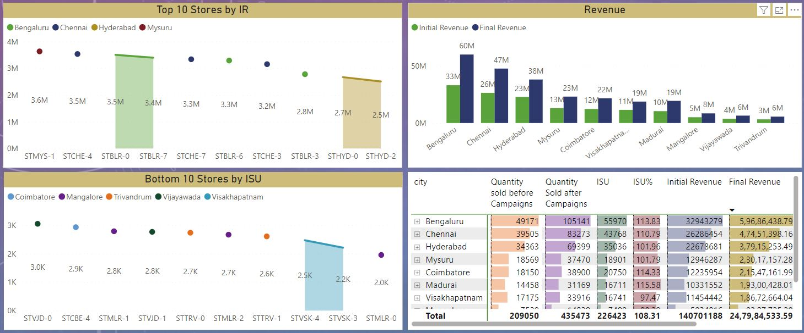
The best performing store is STMYS-1 which is in Mysuru. The fact that it has just 4 stores which are very less compared to Bengaluru where it is 10 has outperformed every other store in terms of IR.
Bengaluru has Highest IR and IR%.

Slide 4
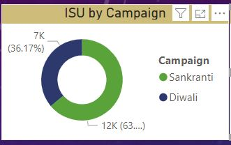
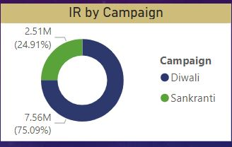
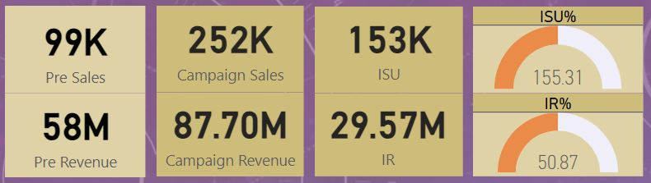
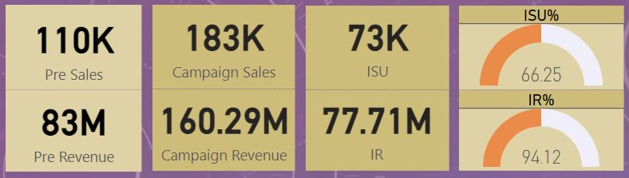
Campaign Analysis Insights
Campaign Analysis Insights
Our Diwali Campaign is a success in terms of IR but in terms of ISU, Sankranti campaign wins. This could be due to the priority of Indians during Diwali which is a bigger festival than Sankranti.
As Diwali is celebrated there is a lot of money spent on different things so people have used promotion wisely.
So, we can use the promotions that we did on Diwali for higher IR and for selling our stock we can use the promotion that did well in Sankranti campaign.
Diwali Sales
Sankranti Sales

Slide 5
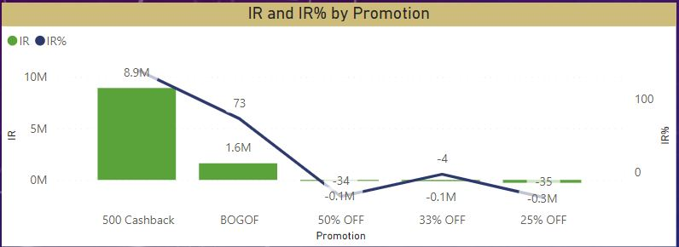
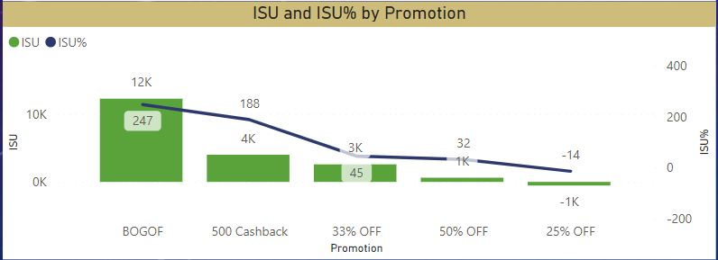
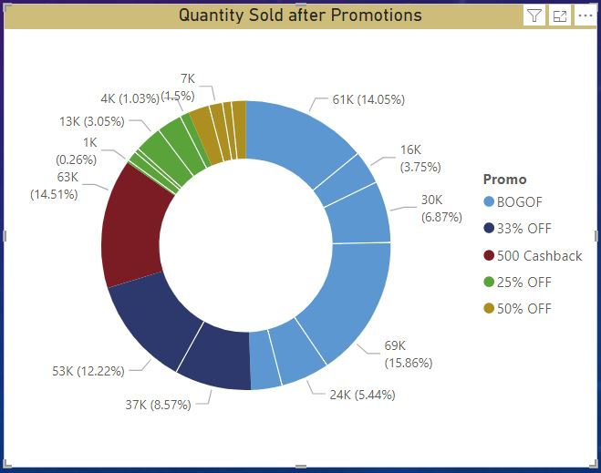
Promotion Analysis Insights
We have leveraged the use of BOGOF and 500 cashback promotion quiet effectively in high price products and combo products but 25% has negative impact in sales vs revenue.
It should be avoided in low price products, creating a bad impact on brand and product value.
It can be used in medium to high price products.
33% OFF has shown good results in medium to high priced by ISU but could still could not manage to turn up the IR%.

Slide 6
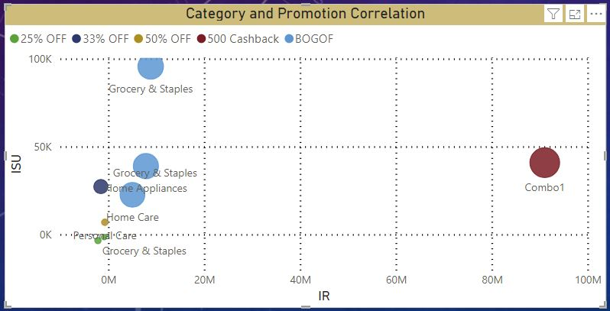
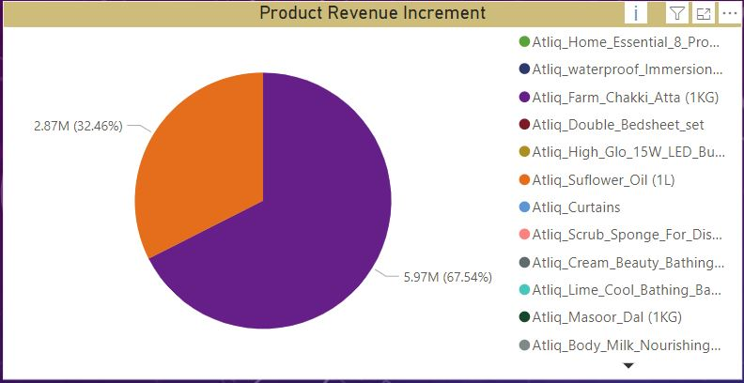
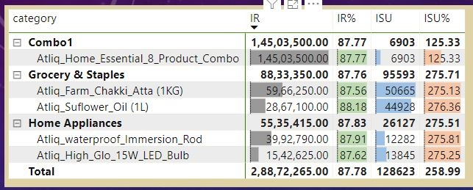
It is clear that the Combo product is the best performing product, after that sunflower oil and Chakki atta are the next best product by IR.
The category which has performed the least is personal care, and it is obvious that the product which are necessary are preferred more than other products. So they can be excluded from discount category during festival season.

